Slide 1
DJANGO MODEL
江琳

Slide 2
Database setup

Slide 3
Django MVT pattern
Model
Read/Write Database
HTTP Request
Url
Forward Request
View
HTTP Response
Template

Slide 4

Database setup
Open up settings.py.
By default, the configuration user SQLite. SQLite is included in Python, so you won’t need to install anything else to support your database.
If you’re new to databases, or you’re just interested in trying Django, this is the easiest choice.
DATABASES = {
'default': {
'ENGINE': 'django.db.backends.sqlite3',
'NAME': os.path.join(BASE_DIR, 'db.sqlite3'),
}
}

Slide 5
What is sqlite?
SQLite is a software library that provides a relational database management system. The lite in SQLite means light weight in terms of setup, database administration, and required resource.
SQLite has the following noticeable features: self-contained, serverless, zero-configuration, transactional.

Slide 6
Database setup
When starting a real project, usually you may want to user a more scalable database like PostgreSQL and MySQL, to avoid database-switching headaches down the road.
To use another database, changing some keys in the DATABASES to match your database connection settings.

Slide 7

Example -- PostgreSQL setup
PostgreSQL
DATABASES = {
'default': {
'ENGINE': 'django.db.backends.postgresql_psycopg2',
'NAME': 'lib',
'USER': 'postgres',
'PASSWORD': 'postgres',
'HOST': '127.0.0.1',
'PORT': '5432',
}
}

Slide 8
Example -- MySQL setup
Mysql
DATABASES = {
'default': {
'ENGINE': 'django.db.backends.mysql',
'NAME': 'lib',
'USER': 'admin',
'PASSWORD': 'root',
'HOST': '127.0.0.1',
'PORT': '',
}
}

Slide 9
ENGINE
sqlite
django.db.backends.sqlite3
PostgreSQL
MySQL
django.db.backends.mysql
Oracle
django.db.backends.oracle
django.db.backends.postgresql

Slide 10
NAME
The name of the database
If using SQLite, the database will be a file on your computer. NAME should be the full absolute path, including filename.
Default value: os.path.join(BASE_DIR, ’db.sqlite3’)

Slide 11
User, password, host, port
USER
The username to user when connecting to the database.
PASSWORD
The password to use when connecting to the database.
HOST
Which host to user when connecting to the database. An empty string means loacalhost.
PORT
The port to user when connecting to the database.

Slide 12
Start an app

Slide 13
Create an Application
A project is a sum of many applications.
Every application has an objective and can be reused into another project.
Applications can live anywhere on your Python.

Slide 14
Create an Application
Create an app named books
$ cd <project folder>
$ python manage.py startapp books

Slide 15

Create an Application
books
migrations
__init__.py
__init__.py
admin.py
apps.py
models.py
tests.py
views.py

Slide 16
Registering the books app
We have to register it with the project so that it will be included.
Open settings.py
Find the definition for the INSTALLED_APPS list
Add the books app at the end of the list.

Slide 17

Registering the posts app
INSTALLED_APPS = (
'django.contrib.admin',
'django.contrib.auth',
'django.contrib.contenttypes',
'django.contrib.sessions',
'django.contrib.messages',
'django.contrib.staticfiles',
'books',
)

Slide 18
Registering the app
apps | explain
django.contrib.admin | Admin site
django.contrib.auth | An authentication system
django.contrib.contenttypes | A framework for content types
django.contrib.sessions | A session framework
django.contrib.messages | A messaging framework
django.contrib.staticfiles | A framework for managing static files

Slide 19
model

Slide 20
Philosophy
A model is the single, definitive source of truth about your data.
It contains the essential fields and behaviors of the data you are storing.

Slide 21
Philosophy
The goal is to define your data model in one place and automatically derive things from it.
A model is a class that represents table or collection in our DB

Slide 22
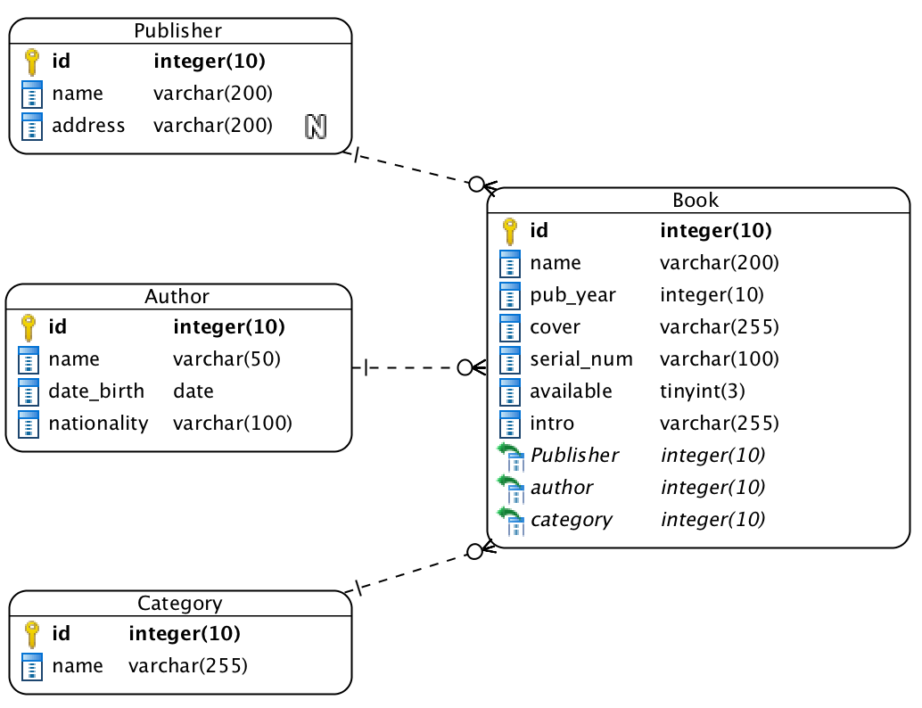
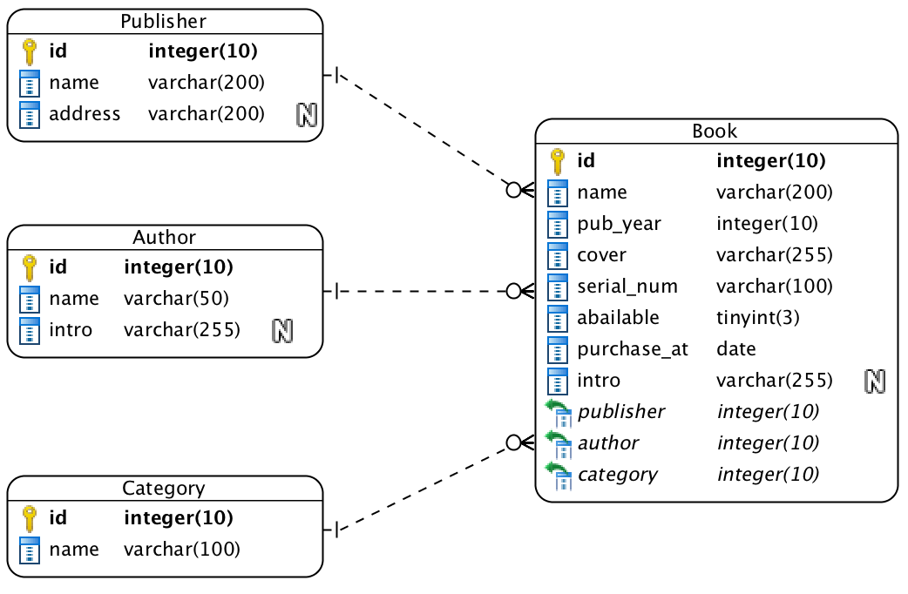
erd

Slide 23
Model -- Publisher
from django.db import models
class Publisher(models.Model):
name = models.CharField(max_length=200)
address = models.CharField(max_length=200, null=True, blank=True)
Each model is represented by a class that subclasses django.db.models.Model
Each model has a number of class variables, each of which represents a database fields in the model.

Slide 24
Field
Each field is represented by an instance of a Field class:
CharField for character fields
DateTimeField for datetimes
IntegerField for integer
TextField for a large text field
BooleanField for a true or false field
ImageField for upload a image
https://docs.djangoproject.com/en/1.11/ref/models/fields/

Slide 25
Model -- Author and Category
class Author(models.Model):
name = models.CharField(max_length=50)
intro = models.TextField(null=True, blank=True)
class Category(models.Model):
name = models.CharField(max_length=100)

Slide 26
Model -- Book
class Book(models.Model):
name = models.CharField(max_length=200)
pub_year = models.IntegerField(default=0)
cover = models.ImageField(upload_to='cover/%Y/%m/%d/')
serial_num = models.CharField(max_length=100)
available = models.BooleanField(default=True)
author = models.ForeignKey(Author)
publisher = models.ForeignKey(Publisher)
category = models.ForeignKey(Category)
intro = models.TextField(null=True, blank=True)
purchase_at = models.DateField(auto_now_add=True)

Slide 27
relationship
One-to-One relationship
models.OneToOneField
Many-to-Many relationship
models.ManyToManyField
One-to-Many relationship
models.ForeignKey()

Slide 28
Activating models
Runing makemigrations:
$ python manage.py makemigrations books
Telling Django that you have make some changes to your models and that you would like the changes to be stored as a migrations

Slide 29
Activating models
$ python manage.py makemigrations books
Migrations for 'books': books/migrations/0001_initial.py
- Create model Author
- Create model Book
- Create model Category
- Create model Publisher
- Add field category to book
- Add field publisher to book

Slide 30
Migrations
Migrations are how Django stores changes to your models – they’re just files.
You can read the migration file at: books/migrations/0001_initial.py

Slide 31
sqlmigrate
The sqlmigrate command takes migration names and returns their SQL:
$ python manage.py sqlmigrate books 0001

Slide 32
migrate
Running migrate to create this model tables in your database:
python manage.py migrate
The migrate command takes all the migrations that haven’t been applied and runs them against your database

Slide 33
Change your models
Run python manage.py makemigrations to create migrations for those change.
Run python manage.py migreate to apply those changes to the database.

Slide 34
Questions?

